Slide 1

Cyber Security Intern-Airowire Anusha Darphal 2BL22IS007
BLDEA’S V.P.Dr.P.G Halakatti College of Engineering & Technology Vijayapur-586103
Dr.P.H.Unki
Professor
Department of Information Science and Engineering
BLDEACET

Slide 2
About Company:
Airowire Networks Private Limited is an Indian technology and system integration company headquartered in Bengaluru, Karnataka.
Established in 2014, the company specializes in networking, cybersecurity, cloud services, managed IT services, and AI-driven operations.
The company provides end-to-end enterprise IT solutions for businesses across different industries.
Key Services
Enterprise Networking Solutions
Cybersecurity Services
Cloud Operations & Cloud Management
Managed IT Services
Network Operations Center (NOC)
Security Operations Center (SOC)
Private 5G and Edge Networking
AI-based IT Infrastructure Solution

Slide 3
CYBER INCIDENT RESPONSE SIMULATION SYSTEM USING PYTHON
INTRODUCTION:
Developed a Cyber Incident Response Simulation System using Python
Simulates the working of an Intrusion Detection System (IDS)
Detects brute force attacks through real-time log monitoring
Automatically responds to suspicious activities by blocking attacker Ips
Generates alerts and security reports for analysis

Slide 4
Objectives:
Simulate normal and malicious login activities
Monitor server logs continuously in real time
Detect brute force attacks using threshold logic
Automatically block suspicious IP addresses
Store attacker details in a database
Generate real-time security alerts
Create security reports for analysis

Slide 5
Technologies Used:
Python
SQLite Database
Python Logging Module
Regular Expressions (Regex)
Requests Library
CSV Module

Slide 6
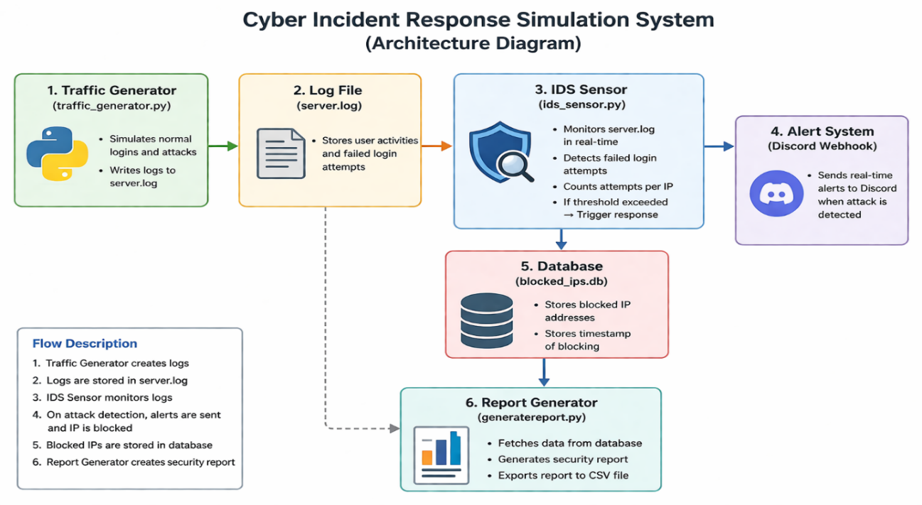
SYSTEM ARCHITECTURE OVERVIEW:

Slide 7
WORKING OF THE SYSTEM:
Generated simulated network traffic using a traffic generator script
Stored login activities in server.log file
Monitored logs continuously using IDS sensor
Detected failed login attempts using regex pattern matching
Counted login failures for each IP address
Identified brute force attacks using threshold-based detection
Blocked malicious IP addresses automatically
Stored blocked IP details and timestamps in database
Sent real-time alerts through webhook integration
Generated security reports and exported them as CSV files

Slide 8
Features Implemented:
Real-time log monitoring
Automated attack detection
Threshold-based intrusion detection
Database integration for blocked IP storage
Alert notification system
Security report generation
Lightweight and efficient system design

Slide 9
Advantages:
Easy to understand and implement
Provides practical cybersecurity exposure
Simulates real-world IDS functionality
Automates attack detection and response
Supports future scalability and enhancements

Slide 10
Future Enhancements:
Integrate with firewall for live IP blocking
Implement machine learning-based threat detection
Add support for DDoS and phishing attack detection
Develop web-based monitoring dashboard
Integrate email and SMS alert systems
Deploy system on cloud platforms

Slide 11
Conclusion
Gained strong understanding of cybersecurity concepts and tools
Developed skills in analyzing threats and identifying vulnerabilities
Understood real-world security mechanisms and protection strategies

